Slide 1

CHAPTER 9 Scaling in the Cloud
|Cloud Computing

Slide 2
Scaling in the Cloud
What is Scaling?
Resource virtualization enables dynamic resource provisioning.
Dynamic provisioning allows scalability of systems and applications.
Systems must efficiently manage resources to balance performance and cost.
Scaling is the ability of a system or function to grow or shrink as required.
Importance: Handles varying workloads without impacting performance or cost.
A scalable system can handle workload increases without performance degradation.

Slide 3
Scalability Metrics
Maximum workload a system can handle is its scalability limit.
Scalability is constrained by system architecture and hardware resources (CPU, memory, disk I/O).
A system's scalability is its ability to maintain performance under increasing demand.

Slide 4
Traditional Computing Scaling
Resource capacity was enhanced manually and remained static even if underutilized.
Resource wastage occurred due to the lack of dynamic infrastructure.
Static scaling often required system restarts, making it inefficient.
Capacity was planned for peak demand, leading to resource wastage.

Slide 5
Cloud Computing Scaling
Dynamic and automatic scaling is possible in the cloud.
Cloud systems adjust capacity without system restarts.
Cloud gives the impression of infinite scalability with virtualized resources.
Reversible Scaling in the Cloud
Dynamic provisioning enables resources to be added or removed on the fly.
Both upward and downward scaling are essential for cost-efficiency.
Downward scaling is more challenging but critical for maintaining performance.

Slide 6
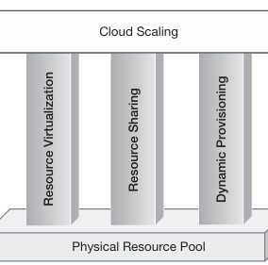
Foundation of Cloud Scaling
Cloud scaling relies on three main pillars:
Resource virtualization: Simplifies management.
Resource sharing: Enables optimal utilization.
Dynamic provisioning: Ensures on-demand scalability.
Together, these create a flexible, scalable cloud system.

Slide 7
Scalable Application Architecture
Applications must be designed for scalability.
Scalable system architecture alone is not enough.
Scalable applications use efficient algorithms, data structures, and database systems.

Slide 8
Scaling Strategies in Cloud
Dynamic scaling happens either manually or automatically.
Auto-scaling is the core feature of cloud scaling, adjusting capacity based on demand.
Two types of auto-scaling:
Proactive scaling: Scheduled, based on expected demand.
Reactive scaling: Adjusts in real-time based on resource utilization.

Slide 9
Proactive Scaling
Anticipates resource demand in advance based on pre-defined schedules.
Two subtypes:
Proactive cyclic scaling: Scales based on regular intervals.
Proactive event-based scaling: Scales during known business events like campaigns.
Ensures resources are provisioned in anticipation of demand spikes.

Slide 10
Reactive Scaling
Adjusts capacity based on actual resource utilization in real-time.
Adds or removes resources automatically when certain thresholds are met (e.g., CPU or memory usage).
More efficient for handling unpredictable or sudden workload spikes.

Slide 11
Benefits of Cloud Scaling
Optimized performance and cost-efficiency through automatic scaling.
Reduced downtime due to the dynamic adjustment of resources.
Flexibility to handle unpredictable workload patterns.
Infinite scalability illusion created by dynamic resource pools.

Slide 12
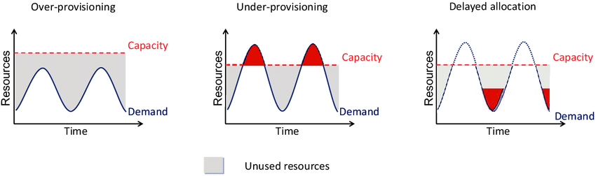
Challenges in Cloud Scaling
Scaling down is more challenging than scaling up.
Performance must be maintained when releasing resources.
Overprovisioning due to inaccurate scaling predictions.

Slide 13
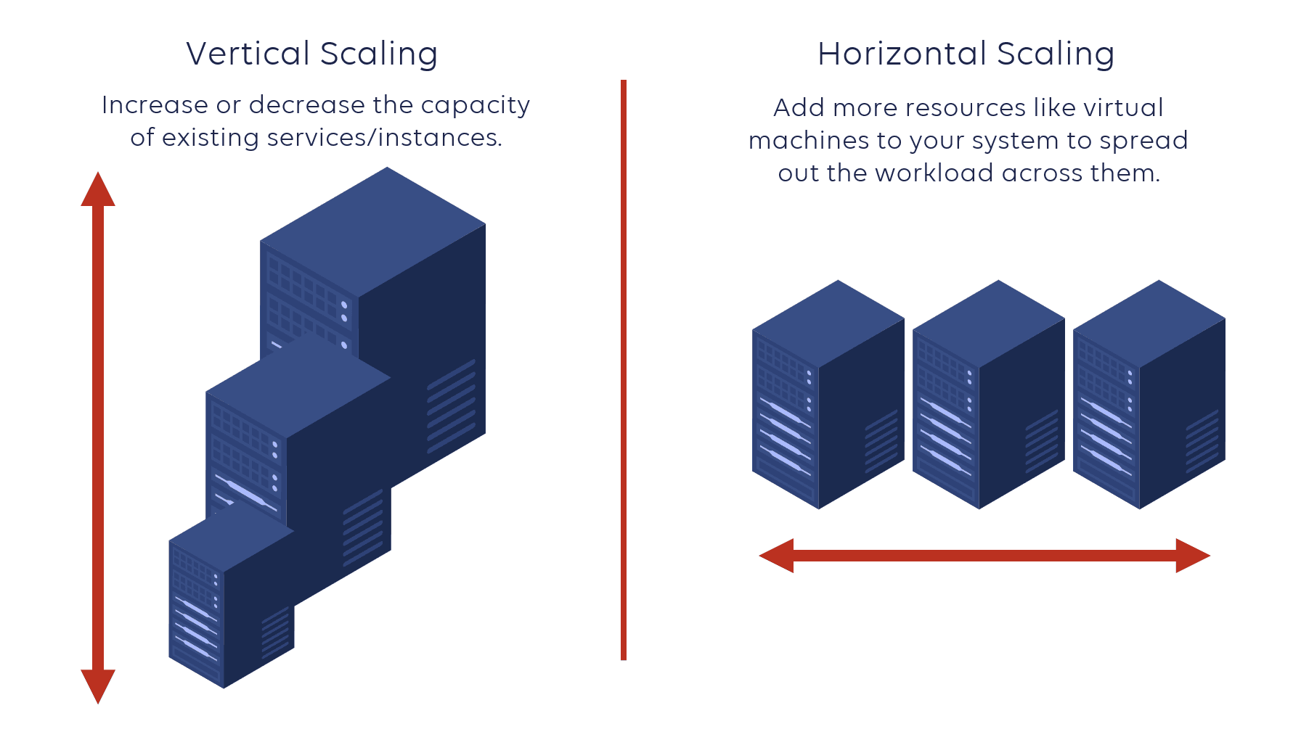
Type of Scaling
Vertical Scaling (Scaling Up)
Horizontal Scaling (Scaling Out)

Slide 14
Vertical Scaling
Overview
Definition: Vertical scaling, or scaling up, involves enhancing the capacity of existing resources by upgrading components.
Example: Replacing a dual-processor with a quad-processor to increase processing power.
How Vertical Scaling Works
Upgrading hardware components (CPU, RAM) within a single node.
Increasing resource capacity without altering the system architecture.
Advantages of Vertical Scaling
Simplicity: Easier to implement with less complexity in management.
Less Risk: Minimal disruption to existing architecture and services.
Familiar Environment: Utilizes existing system setup with upgraded components.
Disadvantages of Vertical Scaling
Cost: High-performance hardware can be expensive and may not be affordable.
Upper Limit: Resources have maximum capacities, leading to potential shortages.
Downtime Risk: Replacing hardware may cause service interruptions and downtime.

Slide 15
Horizontal Scaling
Overview:
Definition: Horizontal scaling, or scaling out, involves adding more resources to the system without replacing existing ones.
Example: Adding additional dual-processor servers to increase total processing power.
How Horizontal Scaling Works
Introducing additional nodes (servers) to distribute load.
Each new node operates alongside existing nodes, increasing overall capacity.
Advantages of Horizontal Scaling
No Downtime: New nodes can be added without service interruption.
Cost-Effective: Utilizes commodity hardware, reducing overall expenses.
Unlimited Scalability: Additional resources can be added without dependency on individual component capabilities.
Disadvantages of Horizontal Scaling
Complexity: Managing numerous distributed nodes can increase system complexity.
Design Challenges: Existing applications may need redesigning for a distributed architecture.
Synchronization: Requires effective load balancing and synchronization between nodes.

Slide 16
Scaling – ANALOGY & TRADE-OFF
Road Infrastructure Analogy:
Vertical Scaling: Upgrading road quality (e.g., better materials) for higher speed (like upgrading hardware).
Horizontal Scaling: Widening roads to accommodate more lanes (adding more servers).
Trade-offs: Decision depends on:
Computational Requirements: System architecture and application design.
Business Factors: Cost, availability, and performance needs.
Flexibility: Both scaling types can be used together based on specific use cases.
Feature | Vertical Scaling | Horizontal Scaling
Known As | Scaling Up | Scaling Out
Method | Replace components | Add more components
Implementation | Any computing environment | Distributed environments only
Complexity | Lower management complexity | Higher due to more nodes
Service Interruption | May cause downtime | No downtime
Hardware Type | High-end hardware | Commodity hardware
Cost | Can become very expensive | More economical and scalable

Slide 17
Cloud-Native Scaling - Horizontal
Cloud Scalability Promise: Horizontal scaling supports infinite scalability without the constraints of vertical scaling.
Auto-Scaling: Automatically adding/removing resources based on load is more aligned with horizontal scaling.

Slide 18
Performance vs. Scalability
Performance: User experience in terms of response time.
Scalability: Ability to maintain performance as user load increases.
Key Insight: An application can be scalable but not necessarily performant.

Slide 19
Resource Contention Problem
Definition: Issues arise when multiple users compete for limited resources, causing bottlenecks.
Stress Points: Identify areas where performance may degrade under load:
Network bandwidth
Application server speed – Process and Memory Speed
Database I/O
Solution: Addressing these bottlenecks through careful design and resource management.

Slide 20
Cloud Bursting and Flexible Scaling
Definition: Cloud bursting allows for temporary resource scaling into the cloud during peak demand.
Example Scenario: An application that runs on-premises can utilize cloud resources during high traffic periods.
Benefits: Provides flexibility and can optimize costs during off-peak periods.

